Slide 1
Chapter 2 Physical layer and Network media

Slide 2
Topics To Be Covered
Network Devices
Different Types of Transmission Medias
Ethernet Cable Standards
Circuit, Message and Packet switching
ISDN

Slide 3
Topics To Be Covered
Network Devices
i. Router
ii. Switch
iii. Hub
iv. Repeater
v. Bridge

Slide 4
Network Devices
Hardware that operates in a network
Components used to connect computers or other electronic device together
Also known as communicating devices

Slide 5
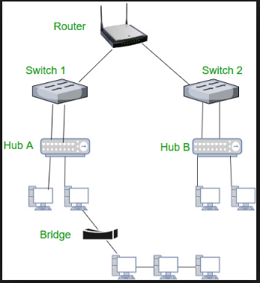

Slide 6
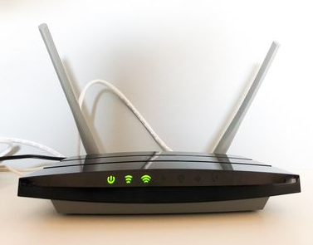
Different Network Devices
Router:
A connectivity device that filters and forwards data based on a logical address
In the case of TCP/IP networks, that would be the IP address
Use routing algorithms, IP addresses for routing data in network
It is a Network layer device
Normally connect LANs and WANs together and have a dynamically updating routing table based on which they make decisions on routing the data packets.
Plays a vital role in controlling traffic and keeping the network efficient.

Slide 7
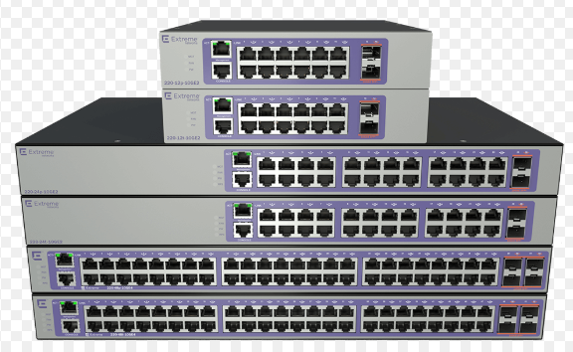
Different Network Devices
Switch:
Networking device that connects network segments
Aware of addresses associated with each of its ports and forwards each incoming data frame to the correct port.
Learn forwarding table using flooding, learning, MAC addresses
Generally it is a Link layer device
Switch can perform error checking before forwarding data, that makes it very efficient as it does not forward packets that have errors and forward good packets selectively to correct port only.

Slide 8
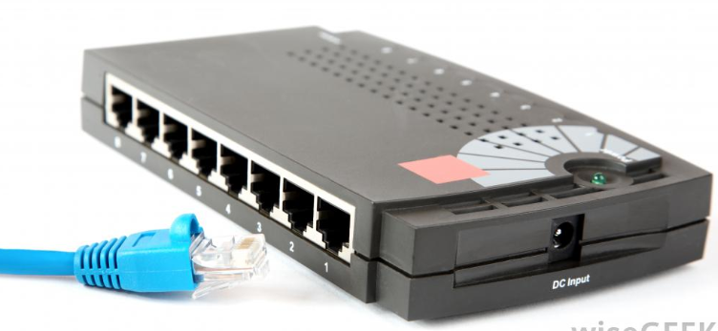
Different Network Devices
Hub:
Is a common connection point for devices in a network.
Network cables are attached to form a network segment..
Hubs typically do not filter data, but instead transmit/retransmit incoming data packets or frames to all parts.
It is a Physical layer device
Also acts as a repeater in that it amplifies signals that deteriorate after traveling long distances over connecting cables.

Slide 9
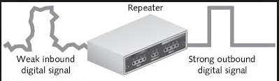
Different Network Devices
Repeater:
An electronic device that amplifies the signal it receives.
Its job is to regenerate the signal over the same network before the signal becomes too weak or corrupted so as to extend the length to which the signal can be transmitted over the same network.
They do not amplify the signal
When the signal becomes weak, they copy the signal bit by bit and regenerate it at the original strength.
It is a Physical layer device

Slide 10
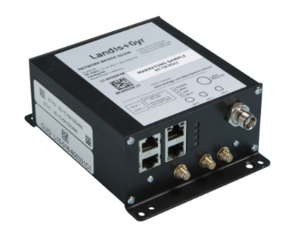
Different Network Devices
Bridge:
Bridges are used to connect two or more hosts or network segments together
Forwards data based on a physical address i.e. they use hardware Media Access Control (MAC) addresses for transferring frames.
Simply bridge is a repeater, with add on functionality of filtering content by reading the MAC addresses of source and destination.
Also used for interconnecting two LANs working on the same protocol.
It is a Physical layer device

Slide 11
Topics To Be Covered
Different Types of Transmission Medias
i. Guided/Wired (twisted pair, coaxial, fiber optics)
ii. Unguided/Wireless (radio waves, micro waves, infrared)

Slide 12
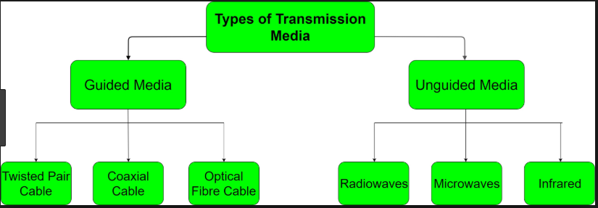
Transmission Medium
Transmission media is a pathway that carries the information from sender to receiver.
physical path between the transmitter and the receiver i.e it is the channel through which data is sent from one place to another.

Slide 13
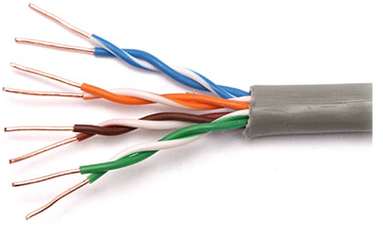
Twisted Pair Cable
It consists of 2 separately insulated conductor wires wound about each other
Widely used transmission media and are of two types.
Unshielded Twisted Pair(UTP):
The quality of UTP may vary from telephone-grade wire to extremely high-speed cable.
The cable has four pairs of wires inside the jacket.
Each pair is twisted with a different number of twists per inch to help eliminate interference from adjacent pairs and other electrical devices.
The tighter the twisting, the higher the supported transmission rate and the greater the cost per foot.

Slide 14
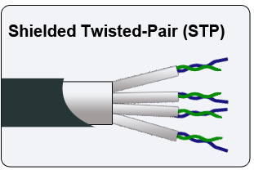
Guided (Wired) Media
Unshielded Twisted Pair(UTP):
Shielded Twisted Pair (STP):
Shielded twisted pair (STP) cable that includes two individual wires covered with a foil shielding, which prevents electromagnetic interference, thereby transporting data faster.
STP cables are costlier when compared to UTP, but has the advantage of being capable of supporting higher transmission rates across longer distances.

Slide 15
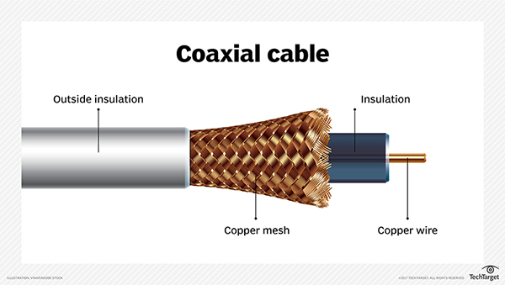
Coaxial Cable
Coaxial cable has a single copper conductor at its center. A plastic layer provides insulation between the center conductor and a braided metal shield. The metal shield helps to block any outside interference from fluorescent lights, motors, and other computers
A Coaxial cable is a cable used in the transmission of video, communications, and audio. This cable has high bandwidths and greater transmission capacity.

Slide 16
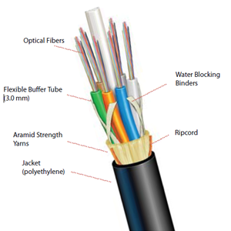
Fiber Optics
Fiber optic cable consists of a center glass core surrounded by several layers of protective materials.
It transmits light rather than electronic signals eliminating the problem of electrical interference.
This makes it ideal for certain environments that contain a large amount of electrical interference.
It has also made it the standard for connecting networks between buildings, due to its immunity to the effects of moisture and lighting.

Slide 17
Unguided Media
Transport electromagnetic waves without using a physical conductor
Referred to as wireless communication.
Radio Waves:
Electromagnetic waves ranging in frequencies between 3 KHz and 1 GHz are normally called radio waves.
Omnidirectional in nature.
Easy to generate and can penetrate through buildings.
The sending and receiving antennas need not be aligned.
Further Categorized as (i) Terrestrial and (ii) Satellite.

Slide 18
Micro Waves:
Electromagnetic waves having frequencies between 1 and 300 GHz are called micro waves.
Unidirectional in nature.
Easy to generate and can penetrate through buildings.
It is a line of sight transmission i.e. the sending and receiving antennas need to be properly aligned with each other.
distance covered by the signal is directly proportional to the height of the antenna

Slide 19
Infrared:
Infrared waves, with frequencies from 300 GHz to 400 THz.
Can be used for short-range communication.
Easy to generate and can penetrate through buildings.
Having high frequencies, cannot penetrate obstacles.
distance covered by the signal is directly proportional to the height of the antenna

Slide 20
Topics To Be Covered
Ethernet Cable Standards
i. UTP
ii. Fiber Cable Standards

Slide 21
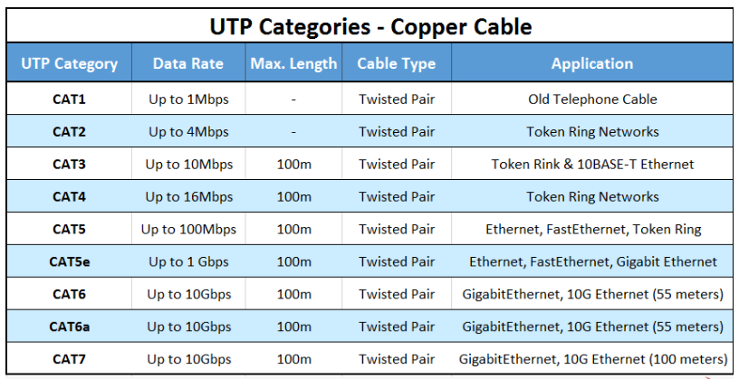
UTP Standard

Slide 22
Fiber Optics Standard
THIEC 61300-3-35 – Fiber Optic Connector End Face Visual Inspection.
IEC 60793-1 and –2 – Optical Fibers (includes several parts)
IEC 60794-1, –2, and –3 – Optical Fiber Cables
G.651 – Characteristics of 50/125um Multimode Graded-Index Optical Fiber
G.652 – Characteristics of Single-mode Optical Fiber and Cable
G.653 – Characteristics of Single-mode Dispersion Shifted Optical Fiber and Cable
G.654 – Characteristics of Cut-off Shifted Single-mode Optical Fiber and Cable
G.655 – Characteristics of Non-zero Dispersion Shifted Single-mode Optical Fiber and Cable
G.656 – Characteristics of Non-zero Dispersion Shifted Fiber for Wideband Transport
G.657 – Characteristics of a Bending Loss Insensitive Single-mode Fiber for Access Networks

Slide 23
Topics To Be Covered
Circuit, Message and Packet Switching
i. Circuit Switching
ii. Packet Switching
iii. Message Switching

Slide 24
Switched Network
A core network, or network core, is the central part of a telecommunications network that provides various services to customers who are connected by the access network.
Switching nodes are used transfer the data from source to destination when transformation is beyond the local area.
Switching nodes provide the switching facility for data to reach their destination by moving different nodes.
There are two fundamental approaches towards building a network core: circuit switching and packet switching.
Massage switching is considered as a old technology and has been phased-out.

Slide 25
Circuit Switching
Circuit switching is simplest method of data communication in which a dedicated physical connection or path is established between the sending and receiving device.
In circuit-switched networks, the resources needed along a path to provide for communication between the end systems are reserved for the duration of the session.
It is a connection oriented service
Circuit-switching systems are ideal for communications that require data to be transmitted in real-time.
The main feature of such a connection is that it provides a fixed data rate channel and both subscribers must operate at this rate.
It is considered inefficient compared to packet switching because channel capacity is completely dedicated for duration of connection.

Slide 26
Circuit Switching
If there is no data at any moment of time, channel capacity goes wasted. Moreover, setting up of connection takes time.
Circuit switching takes place at the physical layer.
In telephone systems circuit switching is used.
Notes:
Data-stream transmissions

Slide 27
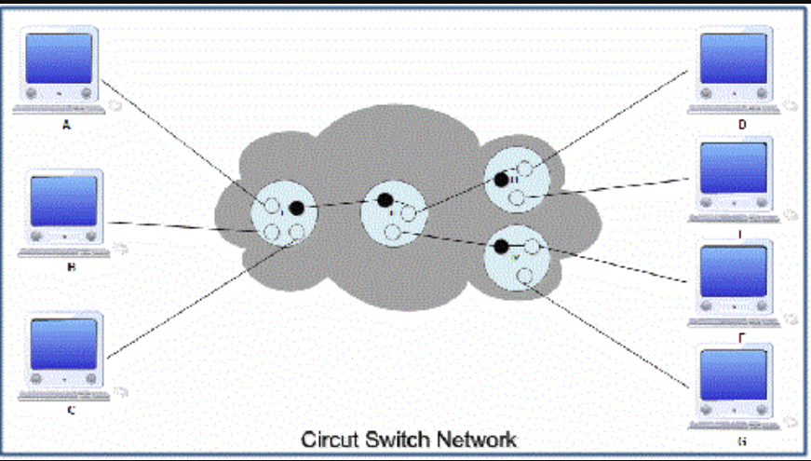
Circuit Switching
Notes:
Connected via switches
Point – point connection lots of line required
II switch routing node

Slide 28
Circuit Switching
Advantages
The dedicated path/circuit established between sender and receiver provides a guaranteed data rate
Once the circuit is established, data is transmitted without any delay as there is no waiting time at each switch
Since a dedicated continuous transmission path is established, the method is suitable for long continuous transmission.
Notes:
Data-stream transmissions

Slide 29
Circuit Switching
Disadvantages
As the connection is dedicated it cannot be used to transmit any other data even if the channel is free.
It is inefficient in terms of utilization of system resources. As resources are allocated for the entire duration of connection, these are not available to other connections.
Dedicated channels require more bandwidth.
Prior to actual data transfer, the time required to establish a physical link between the two stations is too long
Notes:
Data-stream transmissions

Slide 30
Packet Switching
Packet switching is a digital network transmission process in which data is broken into suitably-sized pieces or blocks for fast and efficient transfer via different network devices.
In Packet-Switched networks, these resources are not reserved; a session's messages use the resource on demand, and as a consequence, may have to wait for access to a communication link.
Here data is divided in packets and each packet is given a header containing information of the destination
Using the destination information, packets are forwarded to receiver through the network
At destination, packets are reassembled to get the data.
Packet switched networks allow any host to send data to any other host without reserving the circuit
Multiple paths between a pair of sender and receiver may exist in a packet switched network.

Slide 31
Packet Switching
The route of a packet is decided by network layer protocols.
There are two common packet switching method
Datagram Packet Switching:
Every packet contain full packet of source and destination.
Each packet is forwarded independently based on the destination address.
Routing decisions are made dynamically, so each packet may follow a different route and thus the packages may arrive out of order.
The datagram networks are also referred as connectionless networks.
Internet use datagram approach at the network layer

Slide 32
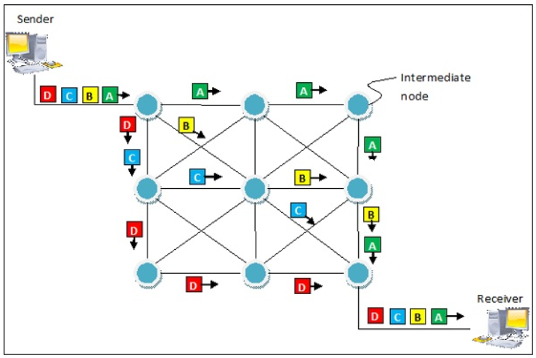
Packet Switching
Datagram Packet Switching:

Slide 33
Packet Switching
Virtual Circuit Packet Switching:
A route is set up prior to packets being sent and packet follow the same route.
Every packet contains the virtual circuit number. As in circuit switching, virtual circuit needs call setup before actual transmission can be started.
Routing is based on the virtual circuit number.
This makes the routing through the network very easy and the packages will be received in the correct order.
A virtual circuit network is normally implemented in the data link layer

Slide 34
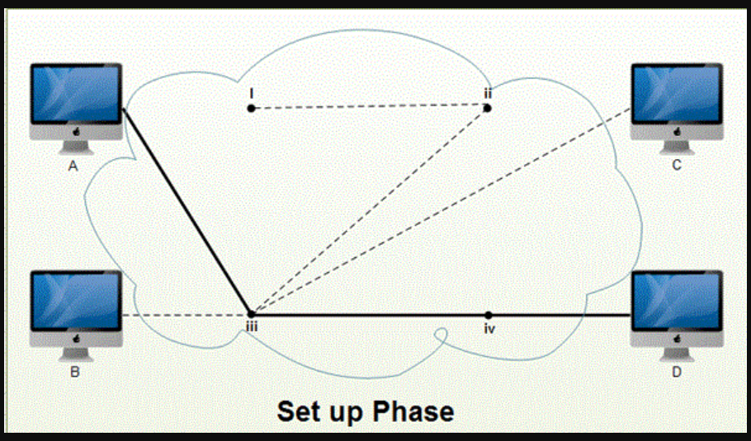
Packet Switching
Virtual Circuit Packet Switching:

Slide 35
Packet Switching
Advantages
Efficient Network
Delay in delivery of packets is less, since packets are sent as soon as they are available.
Switching devices don’t require massive storage, since they don’t have to store the entire messages before forwarding them to the next node.
It allows simultaneous usage of the same channel by multiple users.
It ensures better bandwidth usage as a number of packets from multiple sources can be transferred via the same link.
Notes:
Data-stream transmissions

Slide 36
Packet Switching
Disadvantages
A significant data transmission delay occurs- They are unsuitable for applications that cannot afford delays in communication like high quality voice calls.
Packets may be lost on their route, so sequence numbers are required to identify missing packets.
Switching nodes requires more processing power as the packet switching protocols are more complex.
Requires a high installation cost.
Notes:
Data-stream transmissions

Slide 37
Comparison Circuit Vs Packet Switching
BASIS FOR COMPARISON | CIRCUIT SWITCHING | PACKET SWITCHING
Orientation | Connection oriented. | Connectionless.
Purpose | Initially designed for Voice communication. | Initially designed for Data Transmission.
Flexibility | Inflexible, because once a path is set all parts of a transmission follows the same path. | Flexible, because a route is created for each packet to travel to the destination.
Order | Message is received in the order, sent from the source. | Packets of a message are received out of order and assembled at the destination.
Technology/Approach | Circuit switching can be achieved using two technologies, either Space Division Switching or Time-Division Switching. | Packet Switching has two approaches Datagram Approach and Virtual Circuit Approach.
Layers | Circuit Switching is implemented at Physical Layer. | Packet Switching is implemented at Network Layer.
Notes:
Data-stream transmissions

Slide 38
Message Switching
Message switching was a technique developed as an alternate to circuit switching, before packet switching was introduced.
End users communicate by sending and receiving messages that included the entire data to be shared
Messages are the smallest individual unit.
There are a number of intermediate nodes transfer data and ensure that the message reaches its destination
Provide 2 distinct and important characteristics

Slide 39
Message Switching
a. Store and Forward:
The intermediate nodes have the responsibility of transferring the entire message to the next node.
each node must have storage capacity
A message will only be delivered if the next hop and the link connecting it are both available, otherwise it’ll be stored indefinitely.
A store-and-forward switch forwards a message only if sufficient resources are available and the next hop is accepting data.

Slide 40
Message Switching
b. Message delivery:
This implies wrapping the entire information in a single message and transferring it from the source to the destination node.
Each message must have a header that contains the message routing information, including the source and destination..

Slide 41
Message Switching
Advantages
It provides efficient traffic management by assigning priorities to the messages to be switched
No physical connection is required between the source & destination as it is in circuit switching.
It reduces the traffic congestion on network because of store & forward facility. Each node can store the message until communication channel becomes available.
Channels are used effectively and network devices share the data channels.
It supports the message length of unlimited size.
Notes:
Data-stream transmissions

Slide 42
Message Switching
Disadvantages
As message length is unlimited, each switching node must have sufficient storage to buffer message.
Storing & forwarding facility introduces delay thus making message switching unsuitable for real time applications like voice and video.
The method is costly as store and forward devices are expensive.
Message switching type does not establish dedicated path between the devices, so are not reliable source of communication.
Notes:
Data-stream transmissions

Slide 43
Topics To Be Covered
ISDN
i. Interface
ii. Standard

Slide 44
ISDN Interface
Stand for Integrated Service Digital Network
ISDN is a set of standards for digital transmission over different media created by the Consultative Committee for International Telegraphy and Telephony (CCITT) and the International Telecommunication Union (ITU).
ISDN is a set of communication standards for simultaneous digital transmission of voice, video, data, and other network services over the traditional circuits of the public switched telephone network.
ISDN is a circuit-switched telephone network system, which also provides access to packet switched networks.
Notes:
Data-stream transmissions

Slide 45
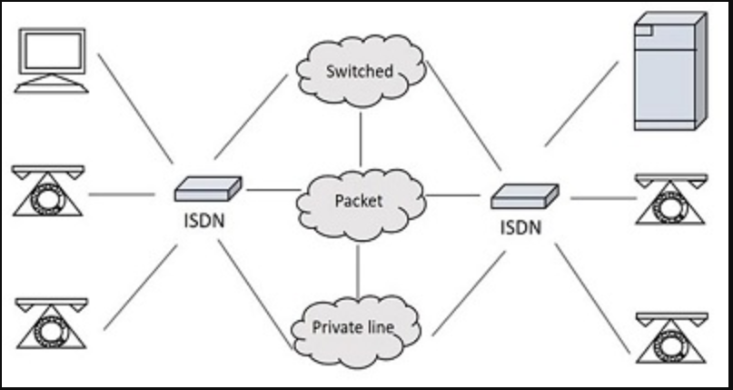
ISDN Interface
Notes:
Data-stream transmissions

Slide 46
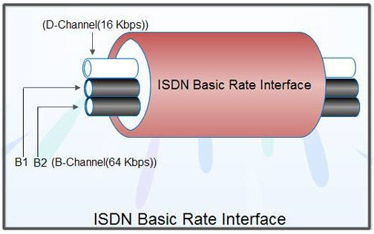
ISDN Interface
Basically there are two user interfaces
Basic Rate Interface (BRI)
Basic Rate Interface specifies a digital pipe, consisting of two 64 Kbps B channels and one 16 Kbps D channel for a total of 144 Kbps (2B+D).
BRI service itself requires 48 Kbps operating overhead so requires 192 Kbps
BRI service is like a large pipe that contains three smaller pipes, two for the B channels and one for the D channel.
All 192 Kbps can be used to carry a single signal
BRI is designed to cater to the needs of home users and small business establishments
Notes:
Data-stream transmissions

Slide 47
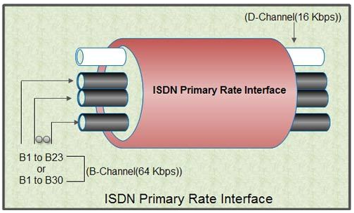
ISDN Interface
Primary Rate Interface (PRI)
PRI intended for users with higher data rate requirements, such as large business establishments, offices with a digital PBX or a LAN
The channel structure for the 1.544 Mbps rate will be 23 B channels and one 64 Kbps D channel
For the 2.048 Mbps rate, 30 B channels and one 64 Kbps D channel.
The United States, Canada and Japan make use of a transmission structure based on 1.544 Mbps
In Europe, 2.048 Mbps is the standard rate.
Notes:
Data-stream transmissions

Slide 48
ISDN Interface
Primary Rate Interface (PRI)
PRI intended for users with higher data rate requirements, such as large business establishments, offices with a digital PBX or a LAN
The channel structure for the 1.544 Mbps rate will be 23 B channels and one 64 Kbps D channel
For the 2.048 Mbps rate, 30 B channels and one 64 Kbps D channel.
The United States, Canada and Japan make use of a transmission structure based on 1.544 Mbps
In Europe, 2.048 Mbps is the standard rate.
Notes:
Data-stream transmissions

Slide 49
ISDN Interface
Primary Rate Interface (PRI) H0 channel structures
This interface supports multiple 384 Kbps HO channels
Structures are 3HO+D and 4 HO for the 1.544 Mbps interface and 5HO +D for the 2.048 Mbps interface
PRI H1 and H12 channel structures
The H1 channel structure consists of one 1,536 Kbps H11 channel.
The H12 channel structure consists of one 1,920 Kbps H12 channel and one D channel.
Notes:
Data-stream transmissions

Slide 50
ISDN Interface
Advantages
As the services are digital, there is less chance for errors
The connection is faster
The bandwidth is higher
Voice, data and video − all of these can be sent over a single ISDN line.
Disadvantages
The disadvantage of ISDN is that it requires specialized digital services and is costlier.
Notes:
Data-stream transmissions

Slide 51
ISDN Standard
Different vendor even with similar features and options may create some capability issue.
CCCIT publish the ISDN standard in 1984 in red binders and known as red book standards.
Standards are revised in 1988 and is known as Blue Book standard
Now CCCIT is known as ITU-T
Two standard in ISDN connectors
For accessing basic rate ISDN, RJ-45 type plug and socket is used using unshielded twisted pair cable.
Access to primary rate ISDN is through a coaxial cable.

